Slide 1
Today
Preview feedback videos: Atmosphere and Cryosphere (albedo)
Talk about grades for the course
Finding the climate sensitivity in EnROADS
Last “Pause for Analysis” of Cambio3.0
Upcoming dates

Slide 2
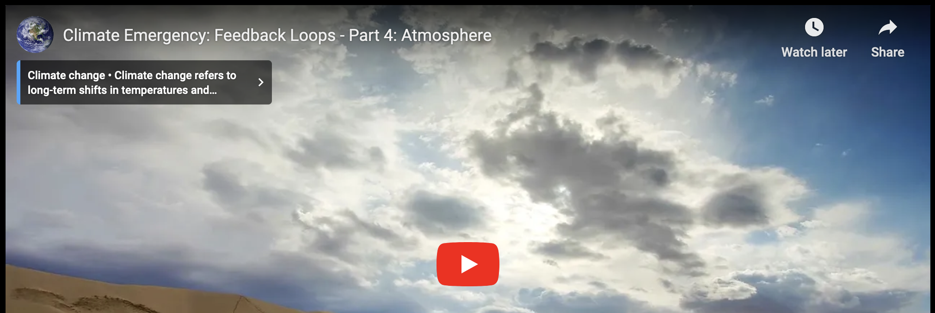
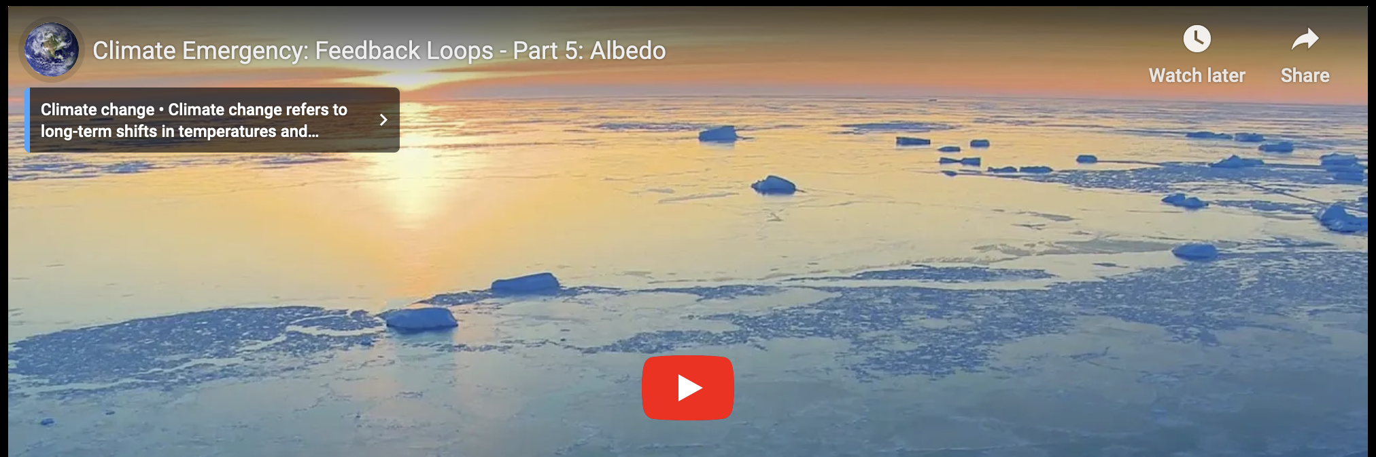
Atmosphere and cryosphere feedback loops

Slide 3
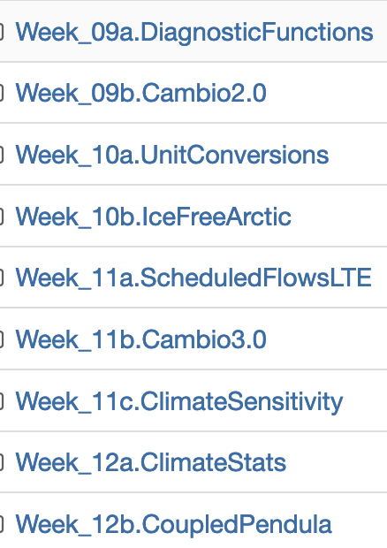
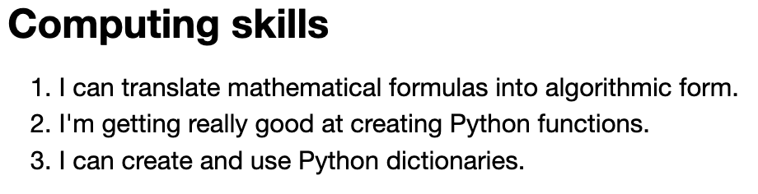
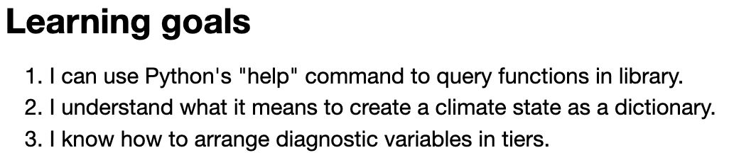
Assigning a grade for the course
Category | Significant gaps | Mostly there | Great command
CGIs
Discussion
Research Notebook
Interviews
Project
Check out the learning goals & skills listed at the bottom of the Introduction of each CGI:

Slide 4
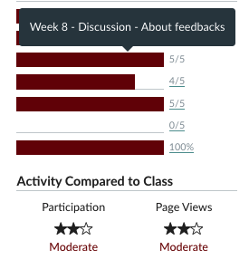
Assigning a grade for the course
Category | Significant gaps | Mostly there | Great command
CGIs
Discussion
Research Notebook
Interviews
Project
You can get up to 2/5 credit for a missing Discussion item as long as it’s submitted before midnight Saturday Nov. 25 (hard deadline)

Slide 5
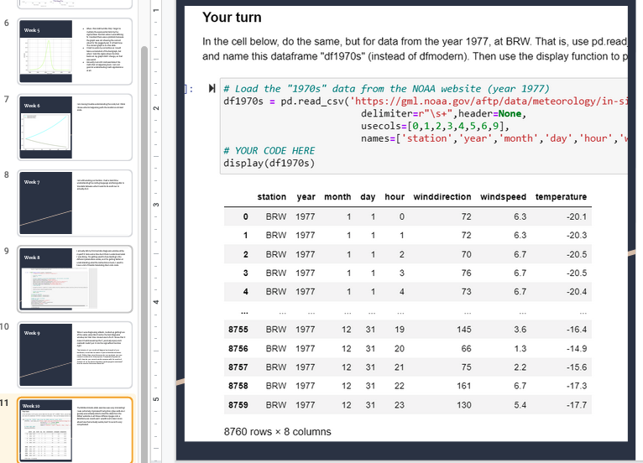
Assigning a grade for the course
Category | Significant gaps | Mostly there | Great command
CGIs
Discussion
Research Notebook
Interviews
Project
This was done in Weeks 1-5

Slide 6
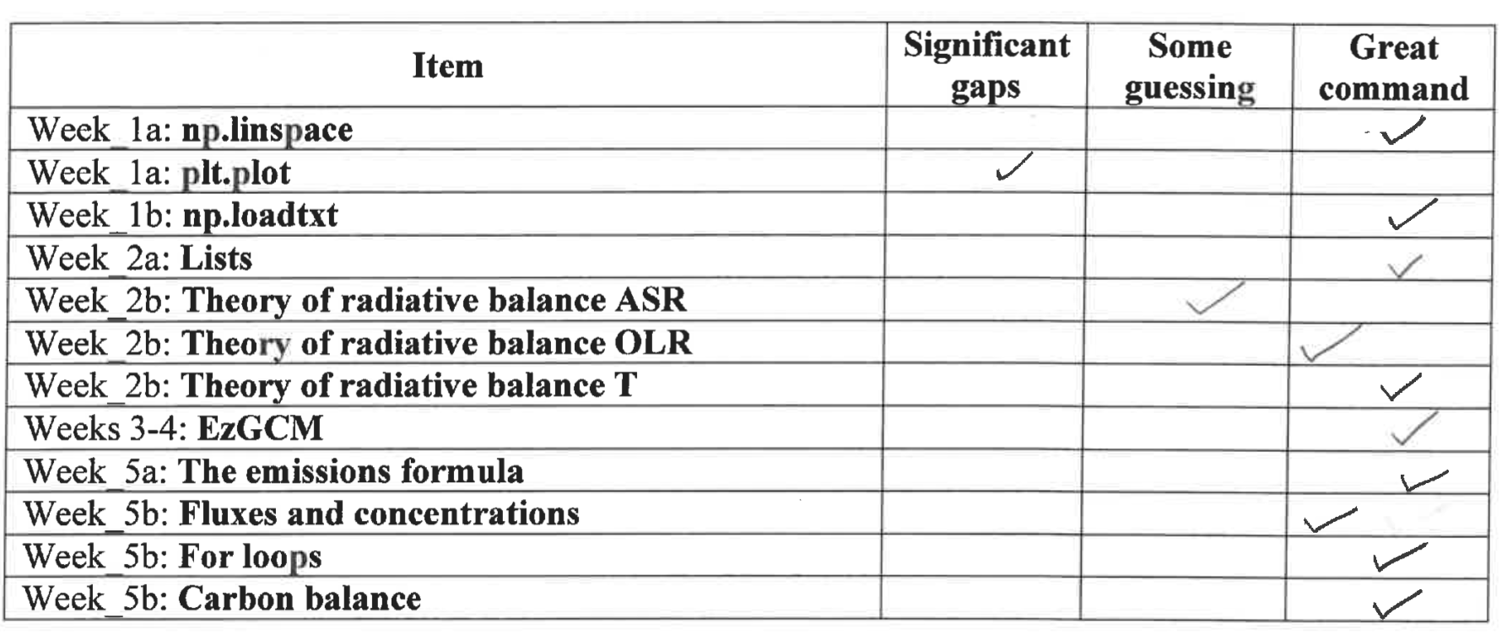
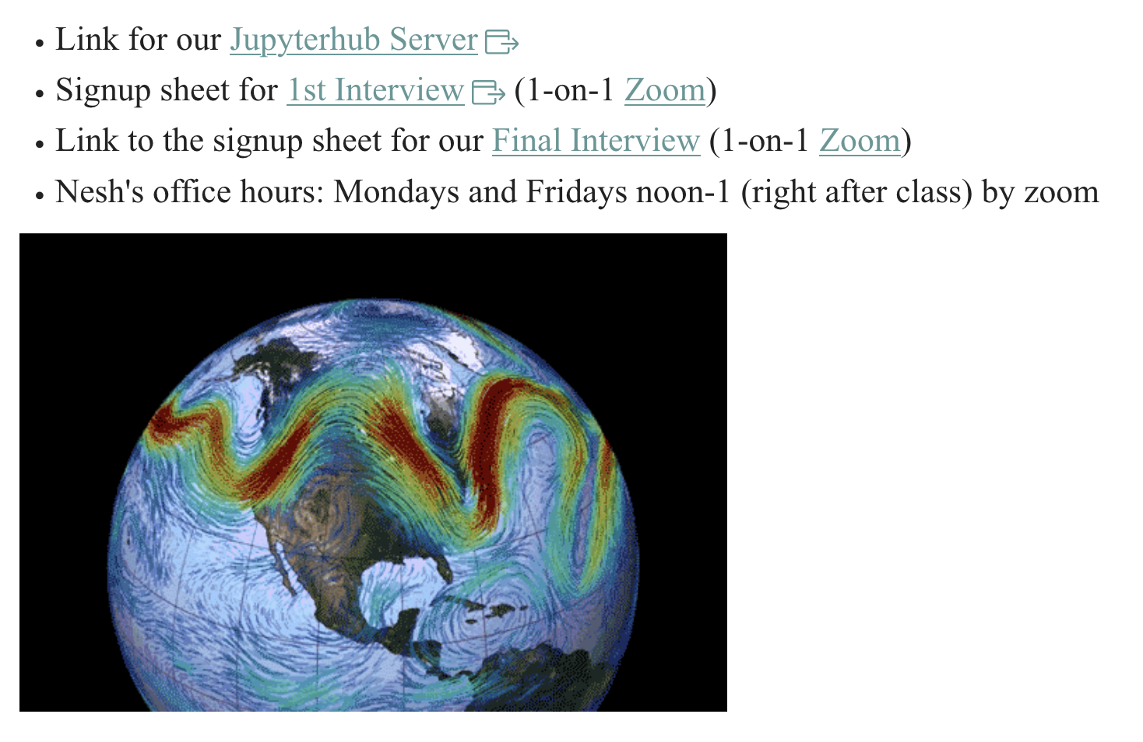
Assigning a grade for the course
Category | Significant gaps | Mostly there | Great command
CGIs
Discussion
Research Notebook
Interviews
Project
Sign up for a slot Finals Week.

Slide 7
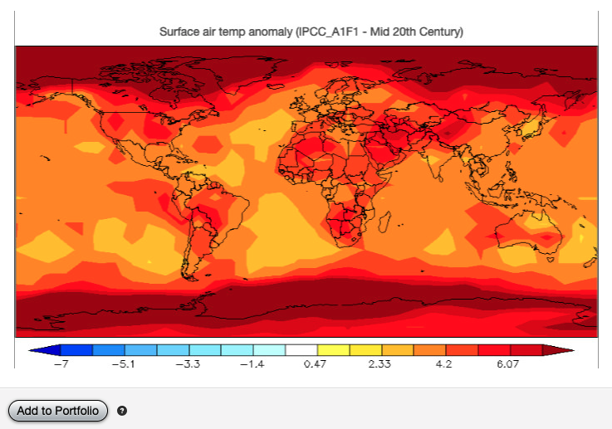
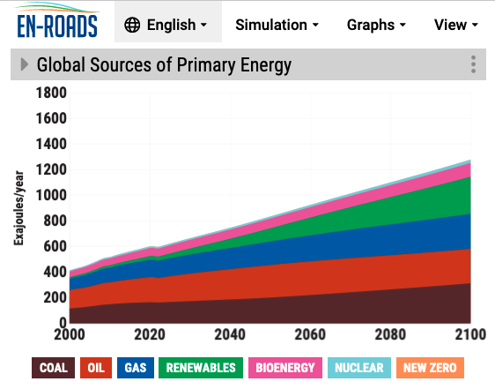
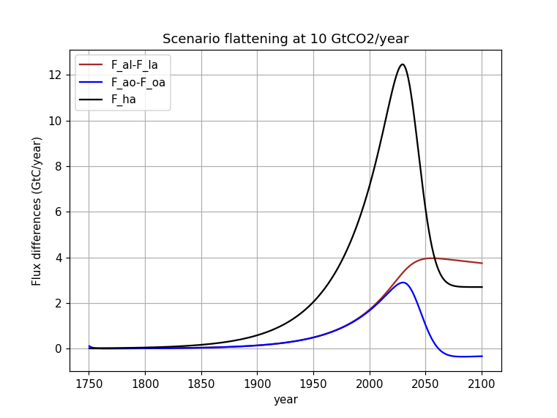
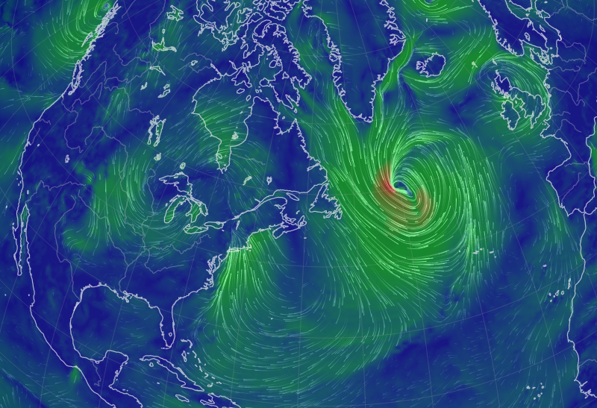
Assigning a grade for the course
Category | Significant gaps | Mostly there | Great command
CGIs
Discussion
Research Notebook
Interviews
Project
20-minute Presentations:
Monday Nov. 27
Wednesday Nov. 29
Friday Dec. 1
(+possibly Monday Dec. 5)

Slide 8
Assigning a grade for the course
Category | Significant gaps | Mostly there | Great command
CGIs |  |  | x
Discussion |  | x
Research Notebook |  |  | x
Interviews |  |  | x
Project |  |  | x
Looks like an “A”
Category | Significant gaps | Mostly there | Great command
CGIs |  | x
Discussion |  |  | x
Research Notebook |  | x
Interviews |  | x
Project |  |  | x
Looks like an “B”
Category | Significant gaps | Mostly there | Great command
CGIs |  | x
Discussion |  |  | x
Research Notebook | x
Interviews | x
Project |  | x
“C” or “D”

Slide 9
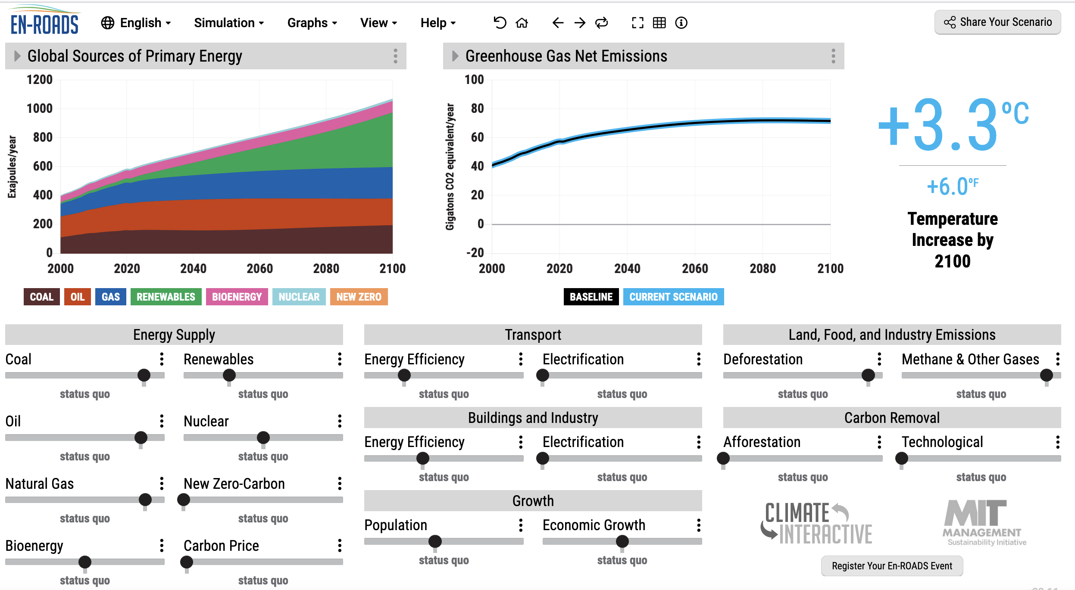
Climate sensitivity in EnROADS
https://en-roads.climateinteractive.org/

Slide 10
Climate sensitivity in EnROADS
https://en-roads.climateinteractive.org/

Slide 11
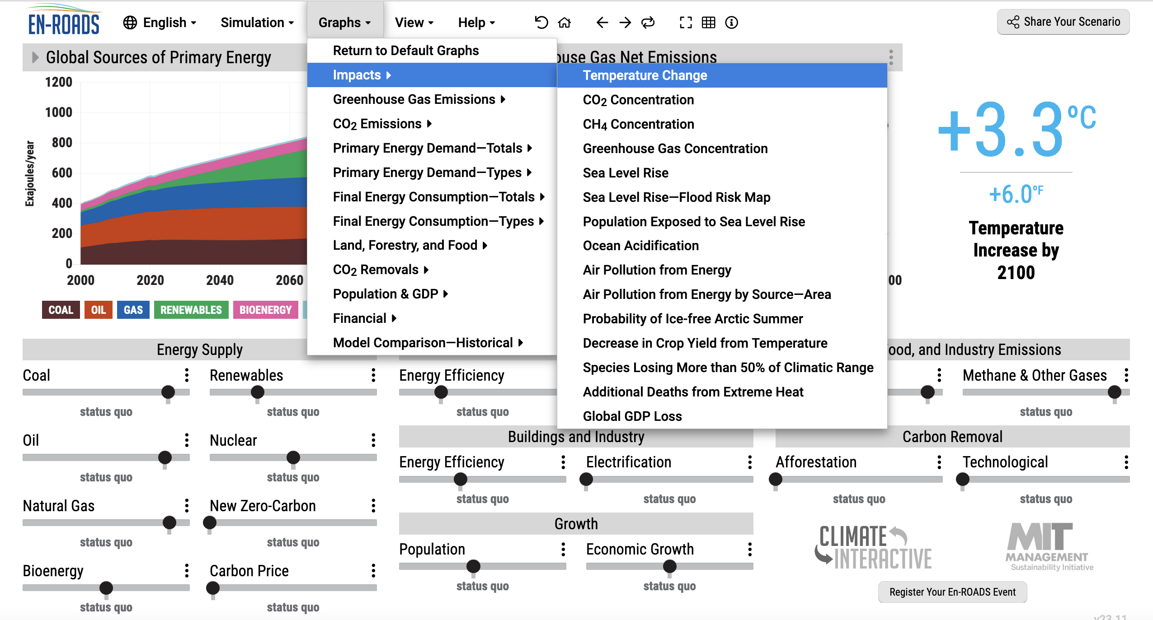
Climate sensitivity in EnROADS
https://en-roads.climateinteractive.org/

Slide 12
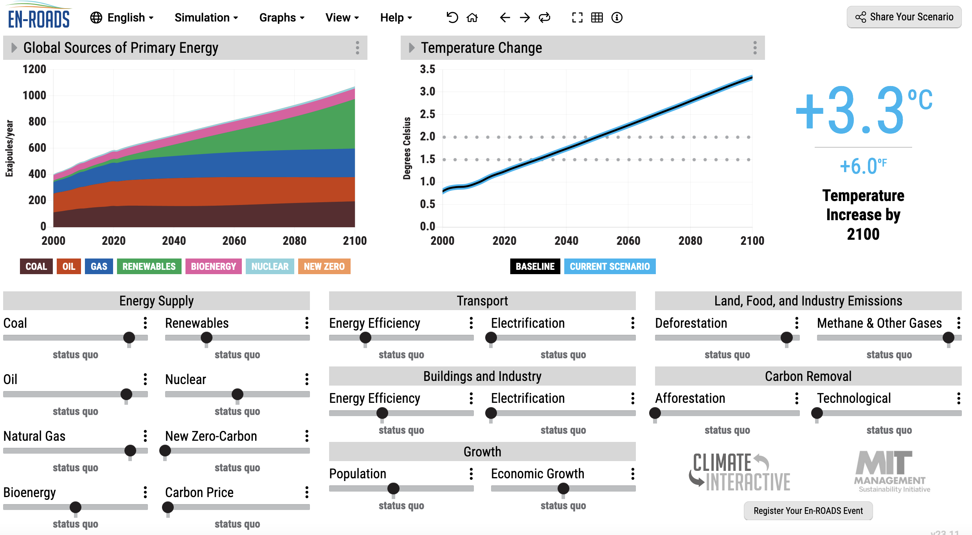
Climate sensitivity in EnROADS
https://en-roads.climateinteractive.org/

Slide 13
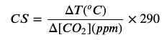
Climate sensitivity in EnROADS
https://en-roads.climateinteractive.org/

Slide 14
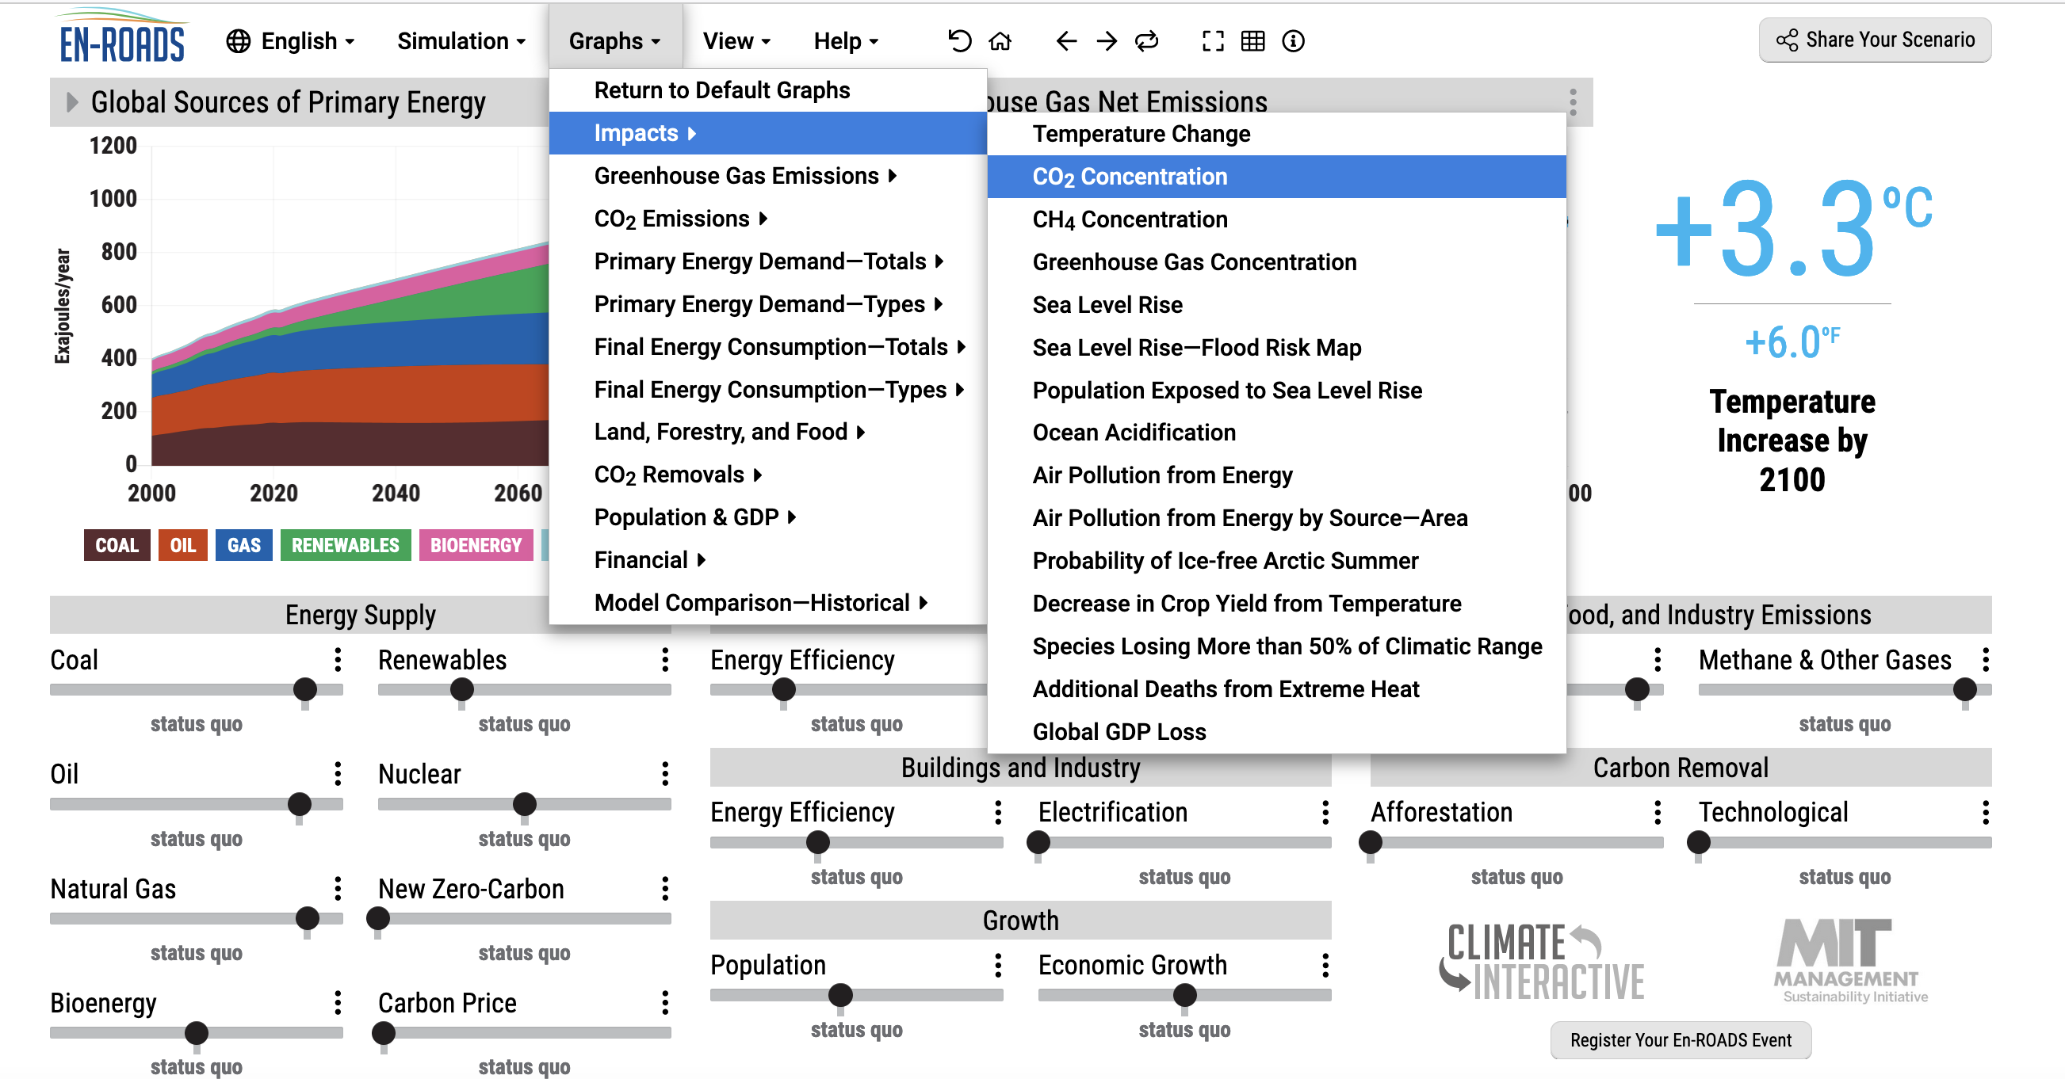
Climate sensitivity in EnROADS
https://en-roads.climateinteractive.org/

Slide 15
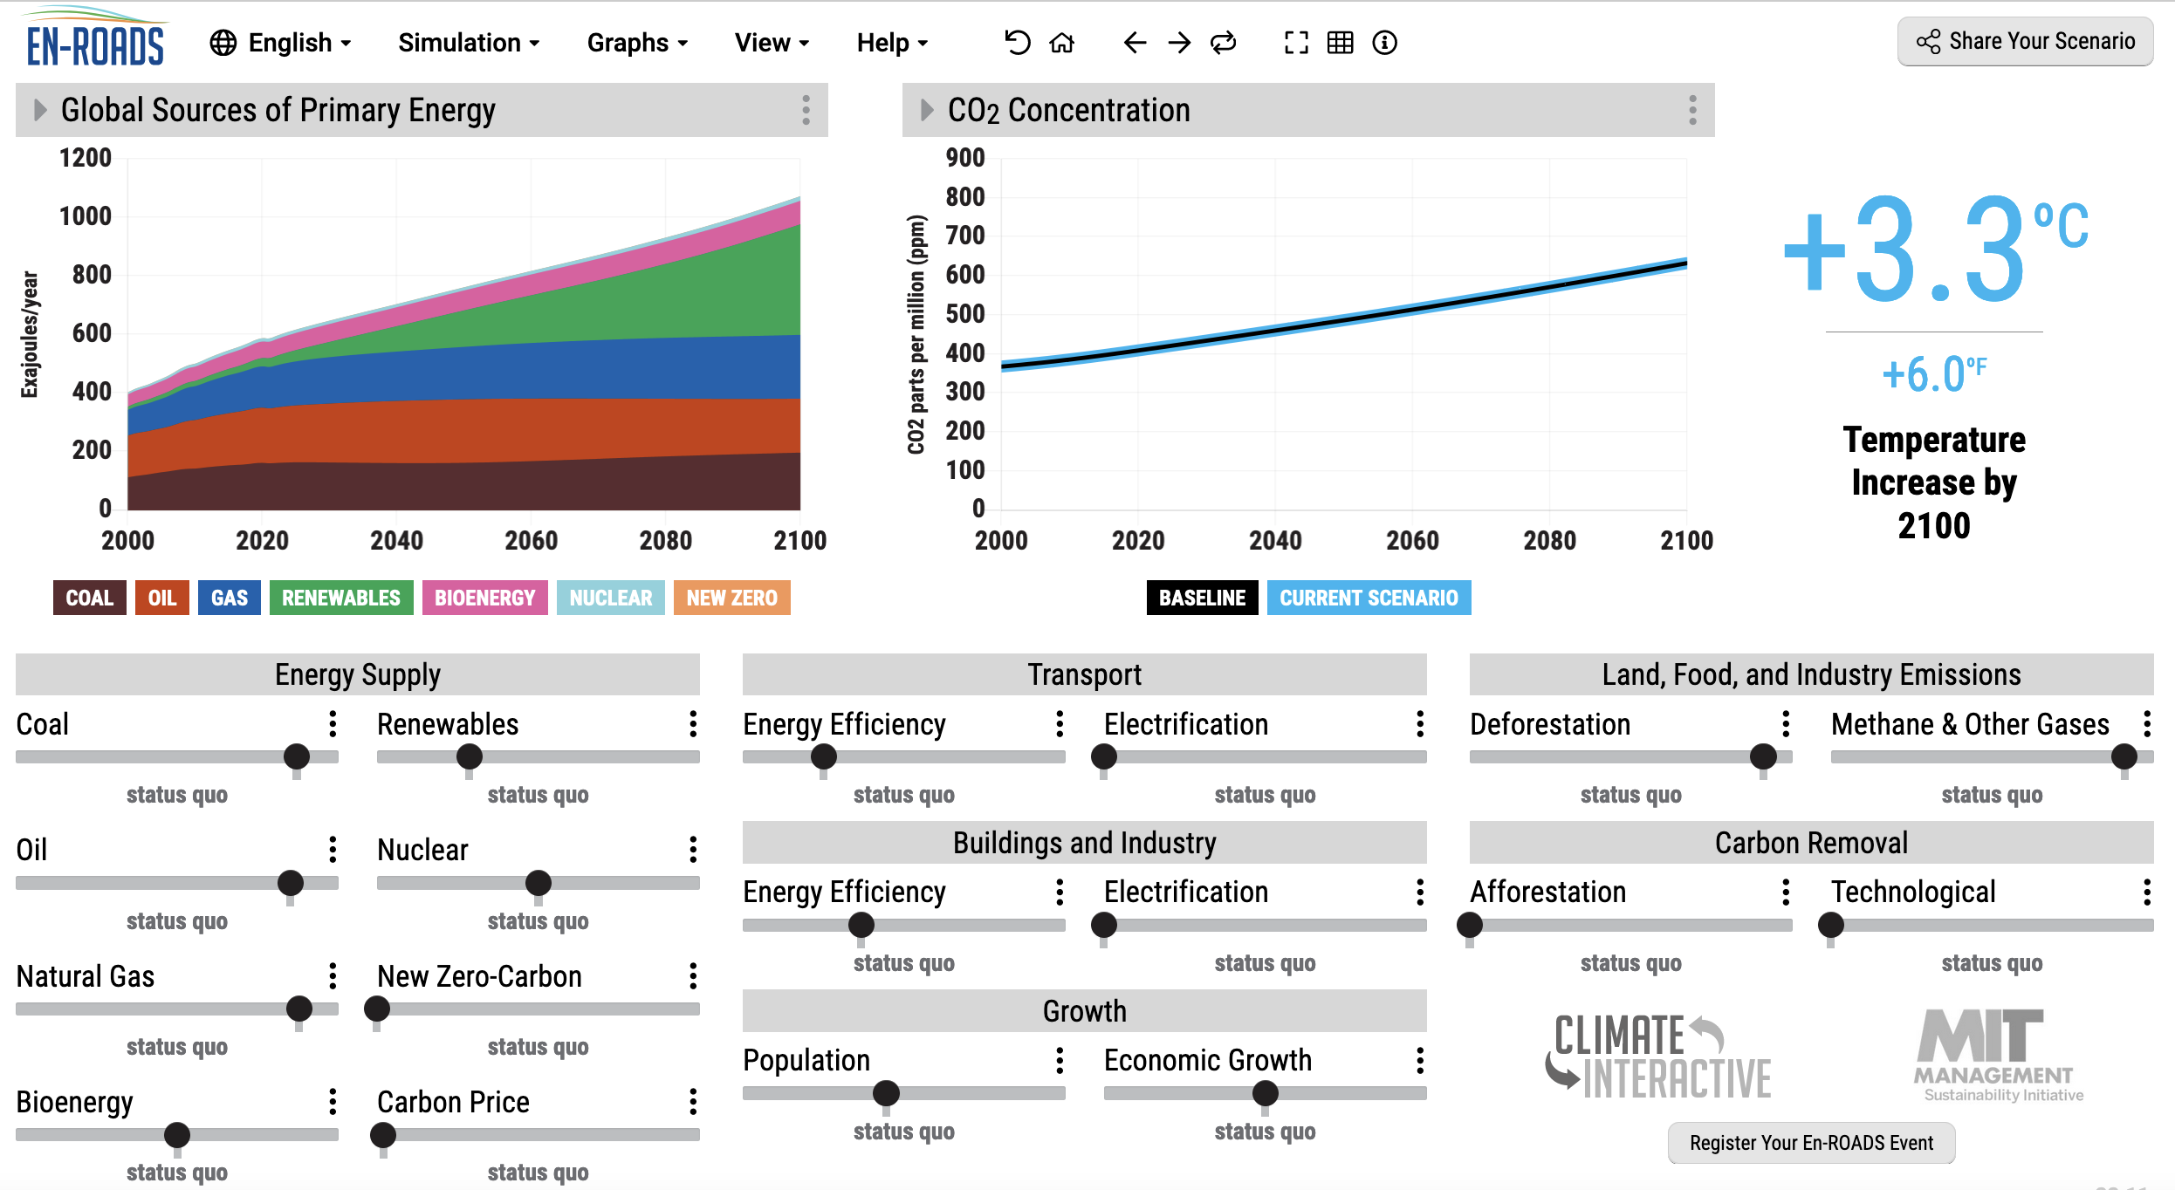
Climate sensitivity in EnROADS
https://en-roads.climateinteractive.org/

Slide 16
Climate sensitivity in EnROADS
https://en-roads.climateinteractive.org/

Slide 17
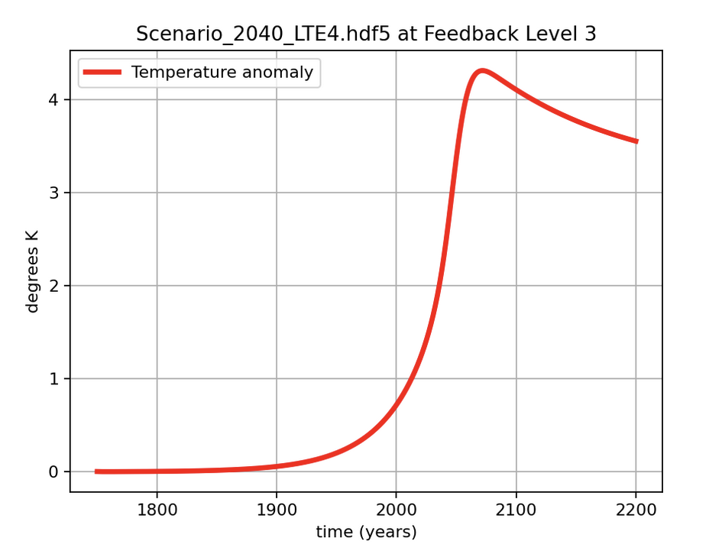
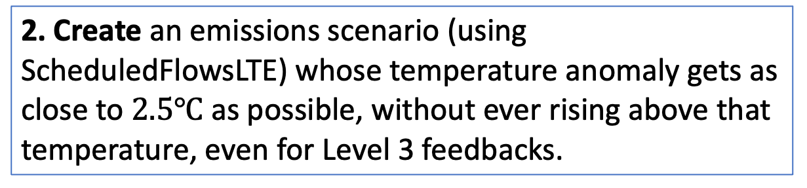
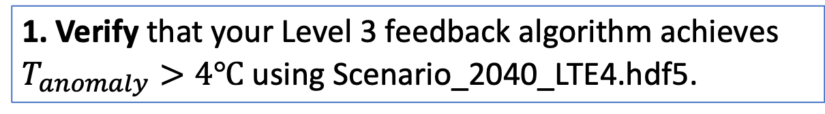
In the last “Pause for Analysis” of Cambio3.0, don’t forget these steps …
1. Verify that your Level 3 feedback algorithm achieves $T_{anomaly}>4℃$ using Scenario_2040_LTE4.hdf5.
2. Create an emissions scenario (using ScheduledFlowsLTE) whose temperature anomaly gets as close to $2.5℃$ as possible, without ever rising above that temperature, even for Level 3 feedbacks.
3. Resubmit Cambio3.0 with that happy scenario in your Cambio3.0 folder.

Slide 18
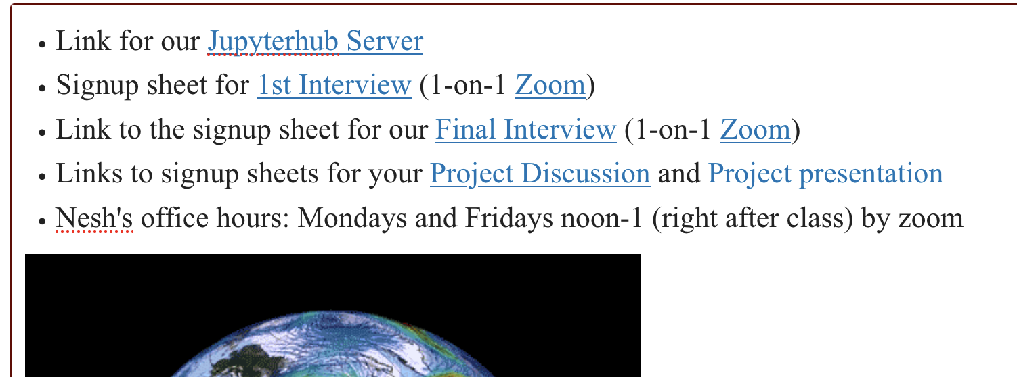
Upcoming dates
Next week (MWF): Climate Statistics
Thanksgiving week (Monday only): Group work on your projects
Following week (MWF): 15-minute Project Presentations
Last week of classes (MW): Evals, wrap-up

